Slide 1

B.M.S. College of
Engineering
MACHINE LEARNING AAT
23DS4PCMLG
AQI PREDICTION AND HEALTH CLASSIFICATION
Shreyas Bairy K S (1BM23CD058)
R V Abhishek (1BM23CD047)
Sushanth S (1BM23CD063)
Ms. Lavanya Naik
Assistant Professor
Department of CSE(Data Science)
BMSCE, Bengaluru

Slide 2

B.M.S. College of
Engineering
Table of Contents
INTRODUCTION
PROBLEM STATEMENT
DATASET DESCRIPTION
IMPLEMENTATION
DEMONSTRATION
FUTURE ENHANCEMENT
Department of Computer Science Engineering(Data Science)

Slide 3
Introduction about the project
B.M.S. College of
Engineering
This project aims to predict the Air Quality Index (AQI) and classify the health impact level using machine learning techniques. By analyzing environmental data such as concentrations of PM2.5, PM10, CO, SO₂, and NO₂, we build predictive models that provide:
Quantitative AQI predictions
Health risk categorization (e.g., Good, Moderate, Poor)
Such intelligent systems can be used by governments, health departments, and individuals to take proactive measures for pollution control and health safety.
Department of Computer Science Engineering(Data Science)

Slide 4
B.M.S. College of
Engineering
Problem Statement
Air pollution is a major environmental risk to health, linked to millions of premature deaths annually. Traditional air quality monitoring systems are limited by high costs, sparse coverage, and lack of real-time analysis.
There is a critical need for a predictive system that can:
Forecast Air Quality Index (AQI) based on real-time environmental data.
Classify health impact levels (e.g., Good, Moderate, Unhealthy) to help individuals and authorities take timely action.
Be scalable and low-cost, enabling deployment across cities, especially in developing regions.
This project addresses this gap by developing machine learning models to predict AQI and classify associated health risks, using publicly available pollution datasets.
Department of Computer Science Engineering(Data Science)

Slide 5
Dataset Description
B.M.S. College of
Engineering
The dataset used in this project contains historical air quality data collected from various monitoring stations
across different cities in India. It includes both pollutant concentration levels and corresponding AQI values.
Key Features:
PM2.5 (Particulate Matter ≤ 2.5 µm)
PM10 (Particulate Matter ≤ 10 µm)
NO₂ (Nitrogen Dioxide)
SO₂ (Sulfur Dioxide)
CO (Carbon Monoxide)
O₃ (Ozone)
AQI (Numerical Index)
AQI_Bucket (Categorical Health Classification)
Target Variables:
AQI (for regression)
AQI Category (for classification)
Department of Computer Science Engineering(Data Science)

Slide 6
Implementation
B.M.S. College of
Engineering
The implementation involves developing two machine learning pipelines—one for AQI prediction (regression) and another for health category classification.
Step 1: Data Preprocessing
Step 2: Model Building
Step 3: Model Evaluation
Step 4: Visualization

Slide 7
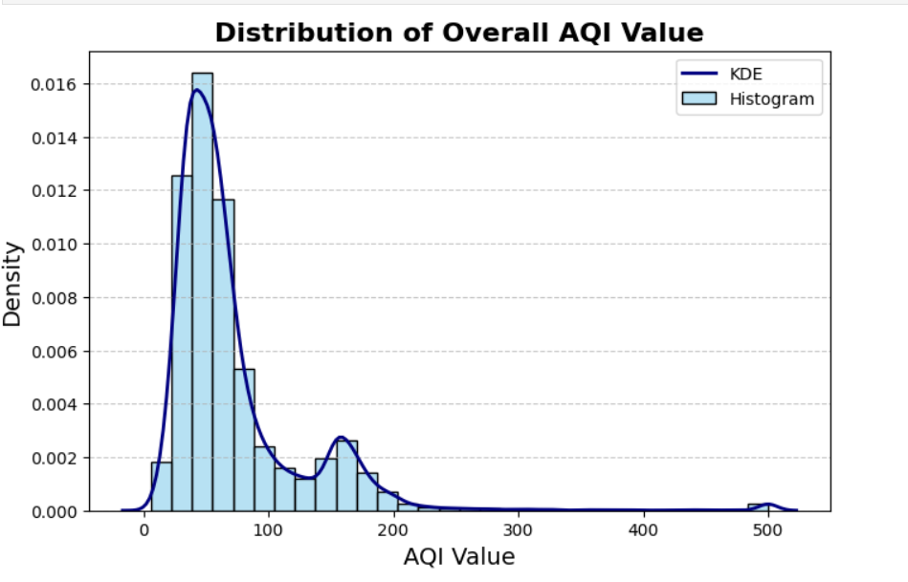
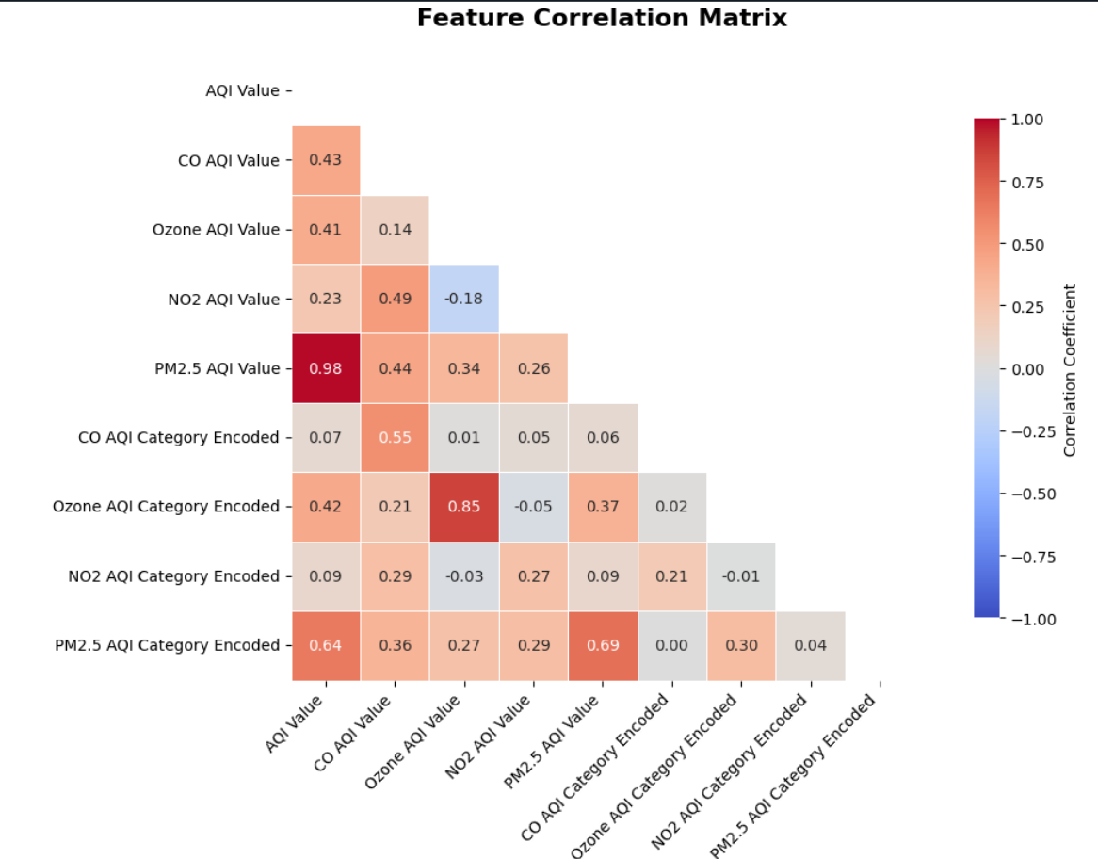
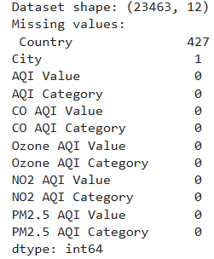
B.M.S. College of
Engineering
Demonstration - EDA
EDA was performed to understand the structure, relationships, and distributions within the dataset before model building.
🔹 Missing Value Analysis:
🔹 Statistical Summary:
🔹 Correlation Analysis:
🔹 Visualizations:
EDA insights guided feature selection and highlighted the importance of PM2.5 and PM10 in AQI prediction.
Department of Computer Science Engineering(Data Science)

Slide 8
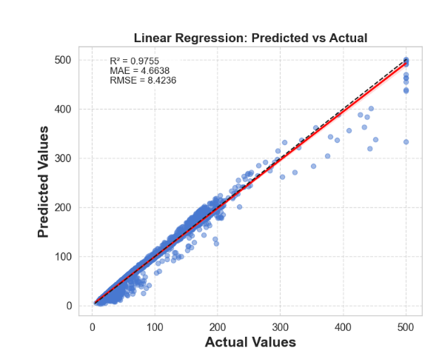
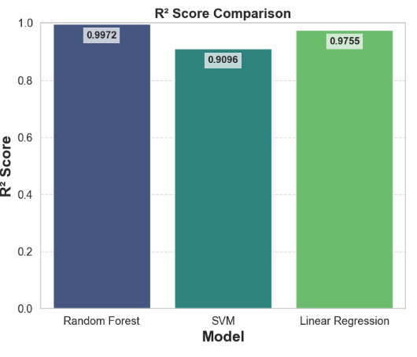
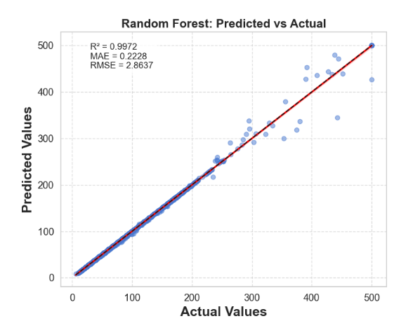
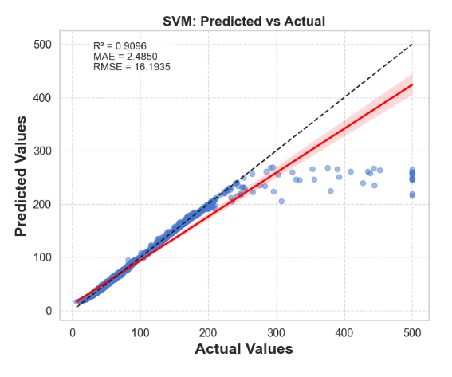
Demonstration - Regression
B.M.S. College of
Engineering
To predict Air Quality Index (AQI) values from environmental features, we compared multiple regression models:
Linear Regressor
SVM
Random Forest Regressor

Slide 9
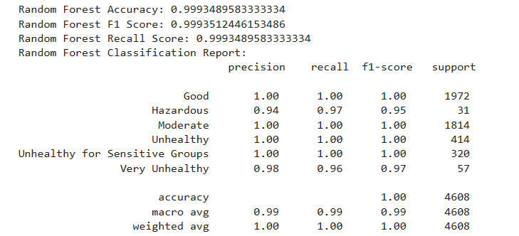
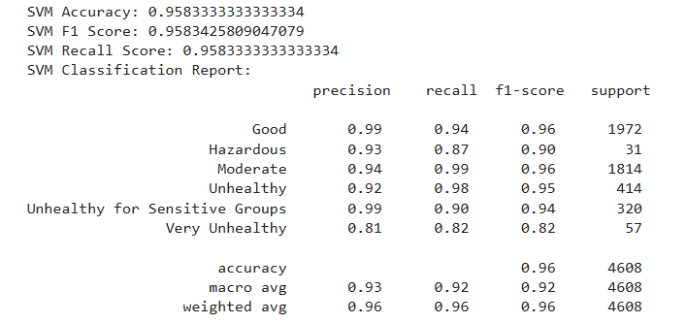
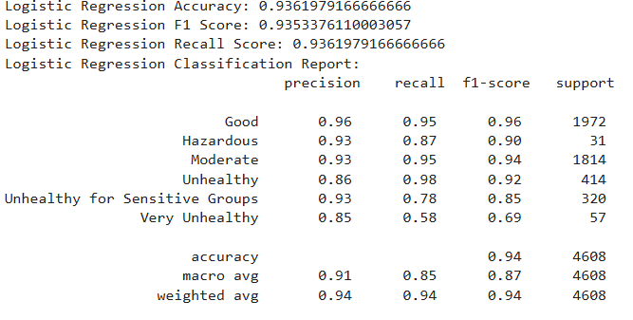
Demonstration - Classification
B.M.S. College of
Engineering
Classification is a supervised machine learning task where the model learns to assign labels to
input data based on learned patterns.
The model’s performance is depicted below:

Slide 10
Future Enhancements
B.M.S. College of
Engineering
1. Integration of Real-Time Data Streams
Incorporate live data from IoT sensors, satellite imagery, and social media feeds to enable dynamic and up-to-date AQI predictions.
2. Personalized Health Risk Assessment
Develop user-specific health alerts by integrating individual health data with AQI forecasts, enhancing personalized healthcare responses.
3. Deployment of Edge Computing Solutions
Utilize edge devices like Raspberry Pi for local data processing, reducing latency and ensuring real-time decision-making in pollution hotspots
4. Expansion to Multimodal Data Sources
Integrate traffic data, meteorological information, and demographic statistics to improve the accuracy and reliability of AQI predictions.

Slide 11
B.M.S. College of
Engineering
THANK YOU
Department of Computer Science Engineering(Data Science)

